Slide 1
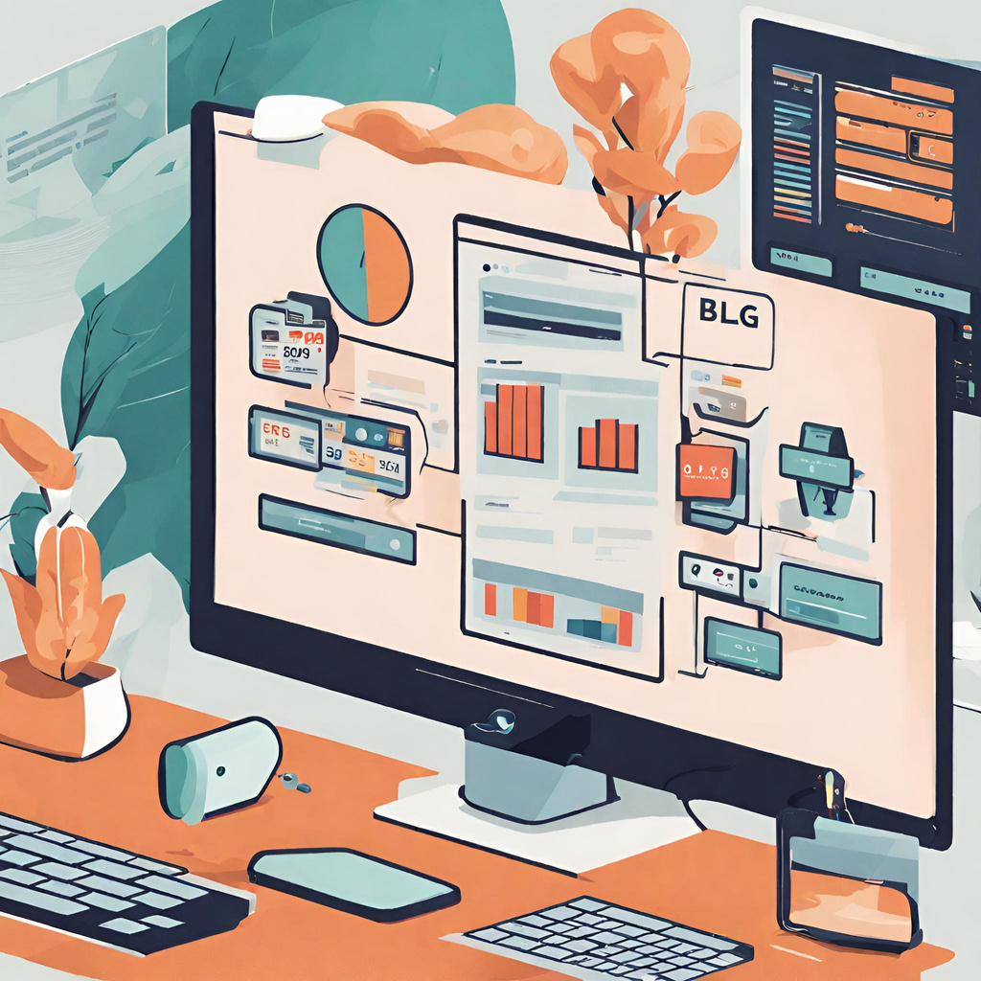
Frontend Team Week 10
Group Members:
Ayca Gökdağ
Doğa Güneş Karadağ
Salih Bulmaz
Semih Gençten
Nour Elhouda Znagui
Baturalp İnce (Data Visualization)
Ayberk Bozkuş (Data Visualization)
Arda Altıntaş (System Integration)
Ubeydullah Önder (System Integration)

Slide 2
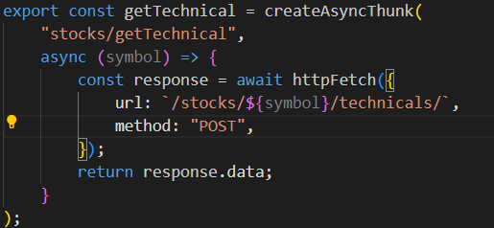
Technicals Page with real Data
Used Enpoint provided by Backend
/equities/{symbol}/technicals
Operations to manage current symbol state

Slide 3
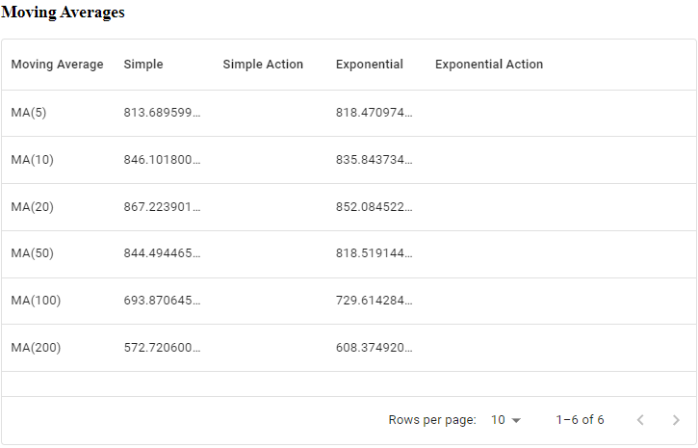
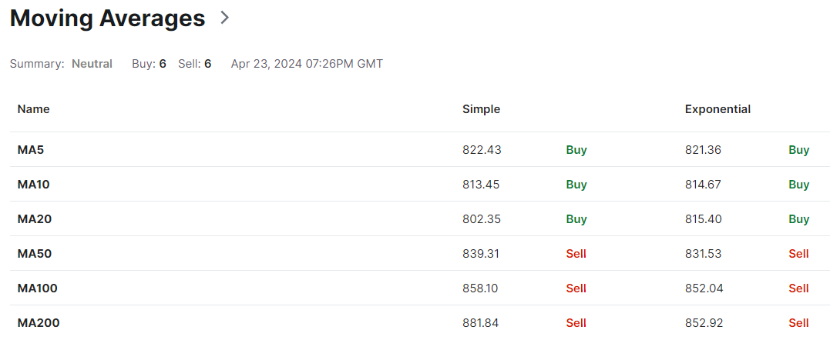
for NVDA
Our MA Table
Investing’s MA Table

Slide 4
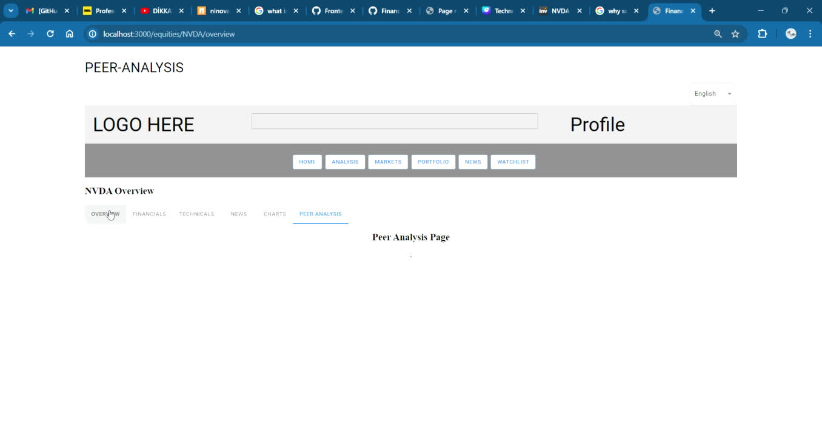
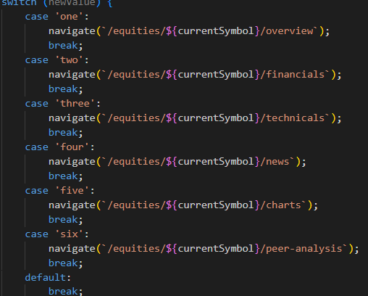
Urls with stock symbols
Pages on tabs share the same symbol now
Overview, Financials, Charts tabs can use symbol
Tested on Technicals page

Slide 5
Financials Page

Slide 6
Data Visualization
Progress
Roadmap
Graph’s visual aspect is improved.
Backend API Connection
Toolbar?
Searchbar on Indicator Popup Menu?
As of now, tooltips are located on the top left position with the following format:
indicator name: value
Video Link (Video on next slide):
https://drive.google.com/file/d/16NK2XHFGIvEFNKqU2Or5pr8wqD489w7U/view?usp=sharing
Tooltip values change based on the point user hovers to.

Slide 7
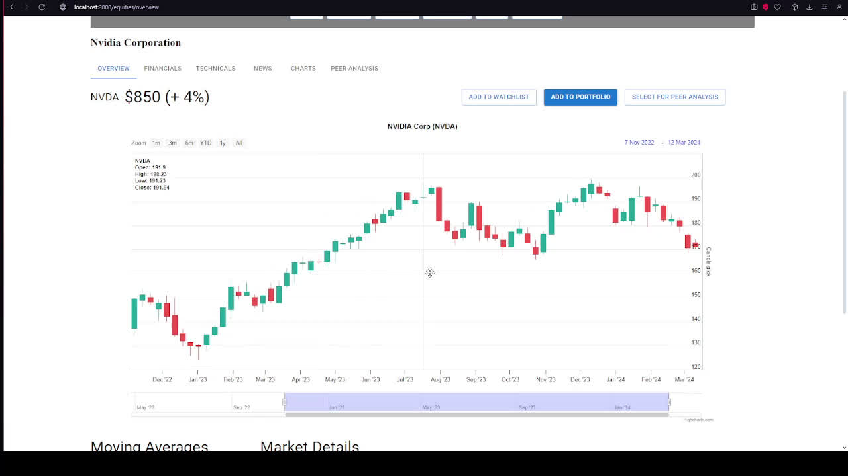

Slide 8

Vercel
Automatic Deployments:
Global CDN:
Serverless Functions:
Custom Domains:
Collaboration Tools:
Usage Limits:

Slide 9
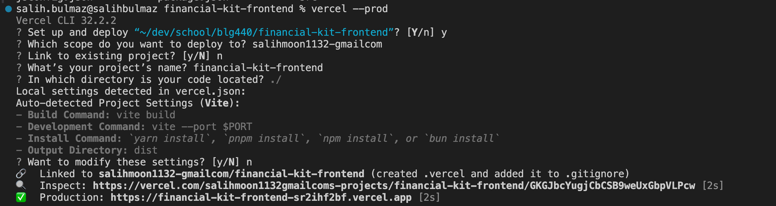
Vercel

Slide 10
Peer Analysis
first step in the project development process, pull real data onto the page using an open-source real-time API, based on information from other websites, before connecting with the backend.
In the initial stage, demo is prepared to show that I can directly fetch real-time information from an API alongside company information from the previous page.

Slide 11
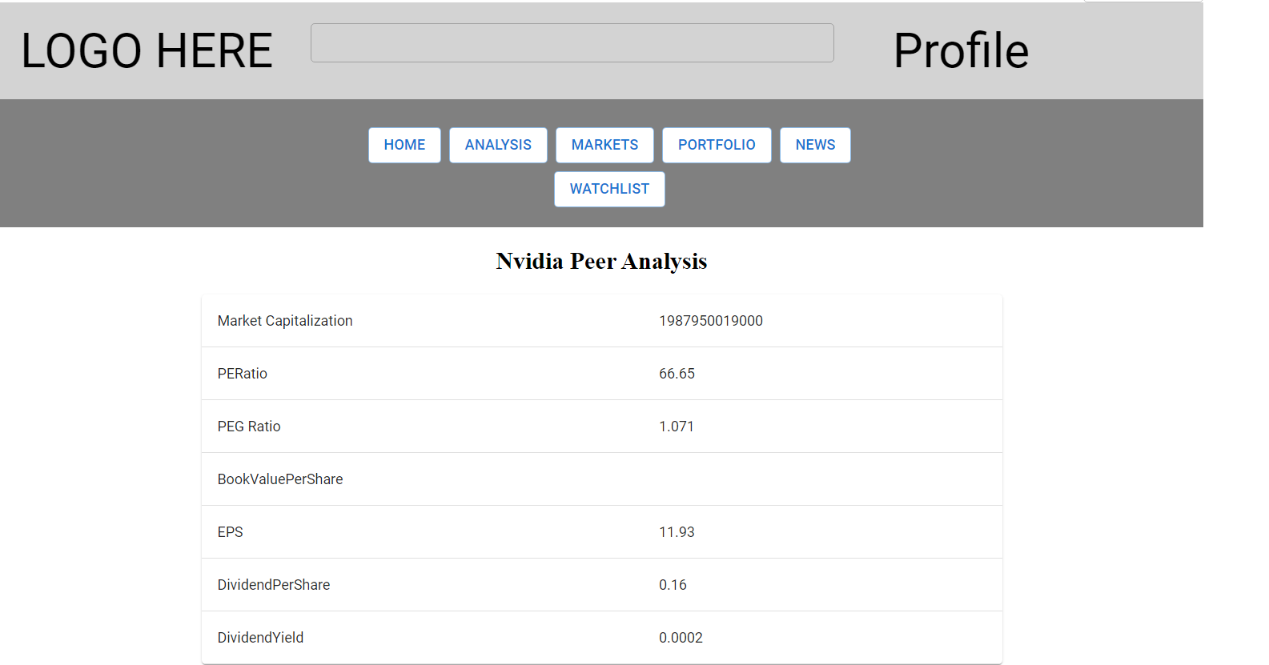

Slide 12
Next Week
UI updates will be made
Necessary analysis instruments will be added according to the feedback received.
Once the general design is determined, it will be applied to the relevant pages.

Slide 13
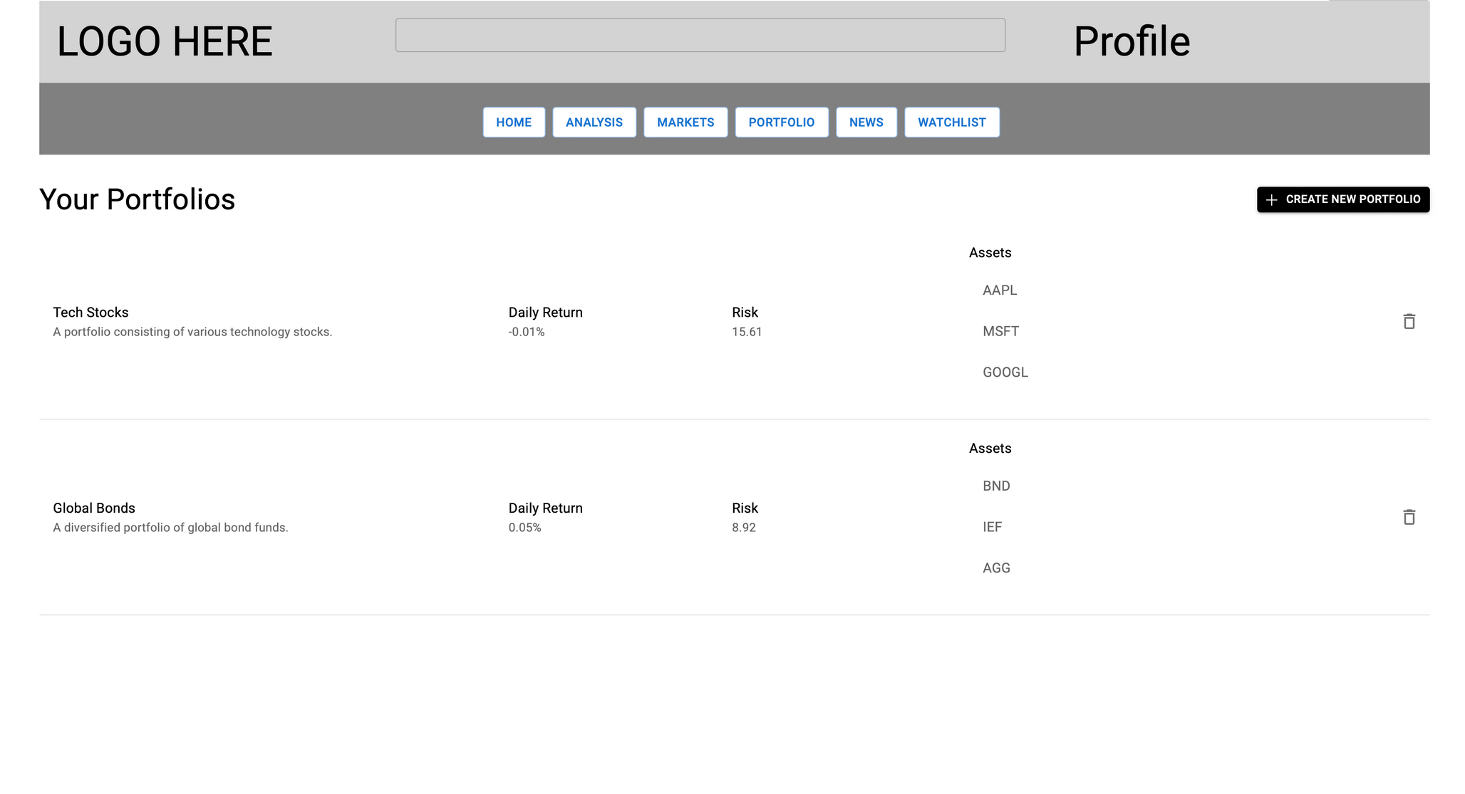
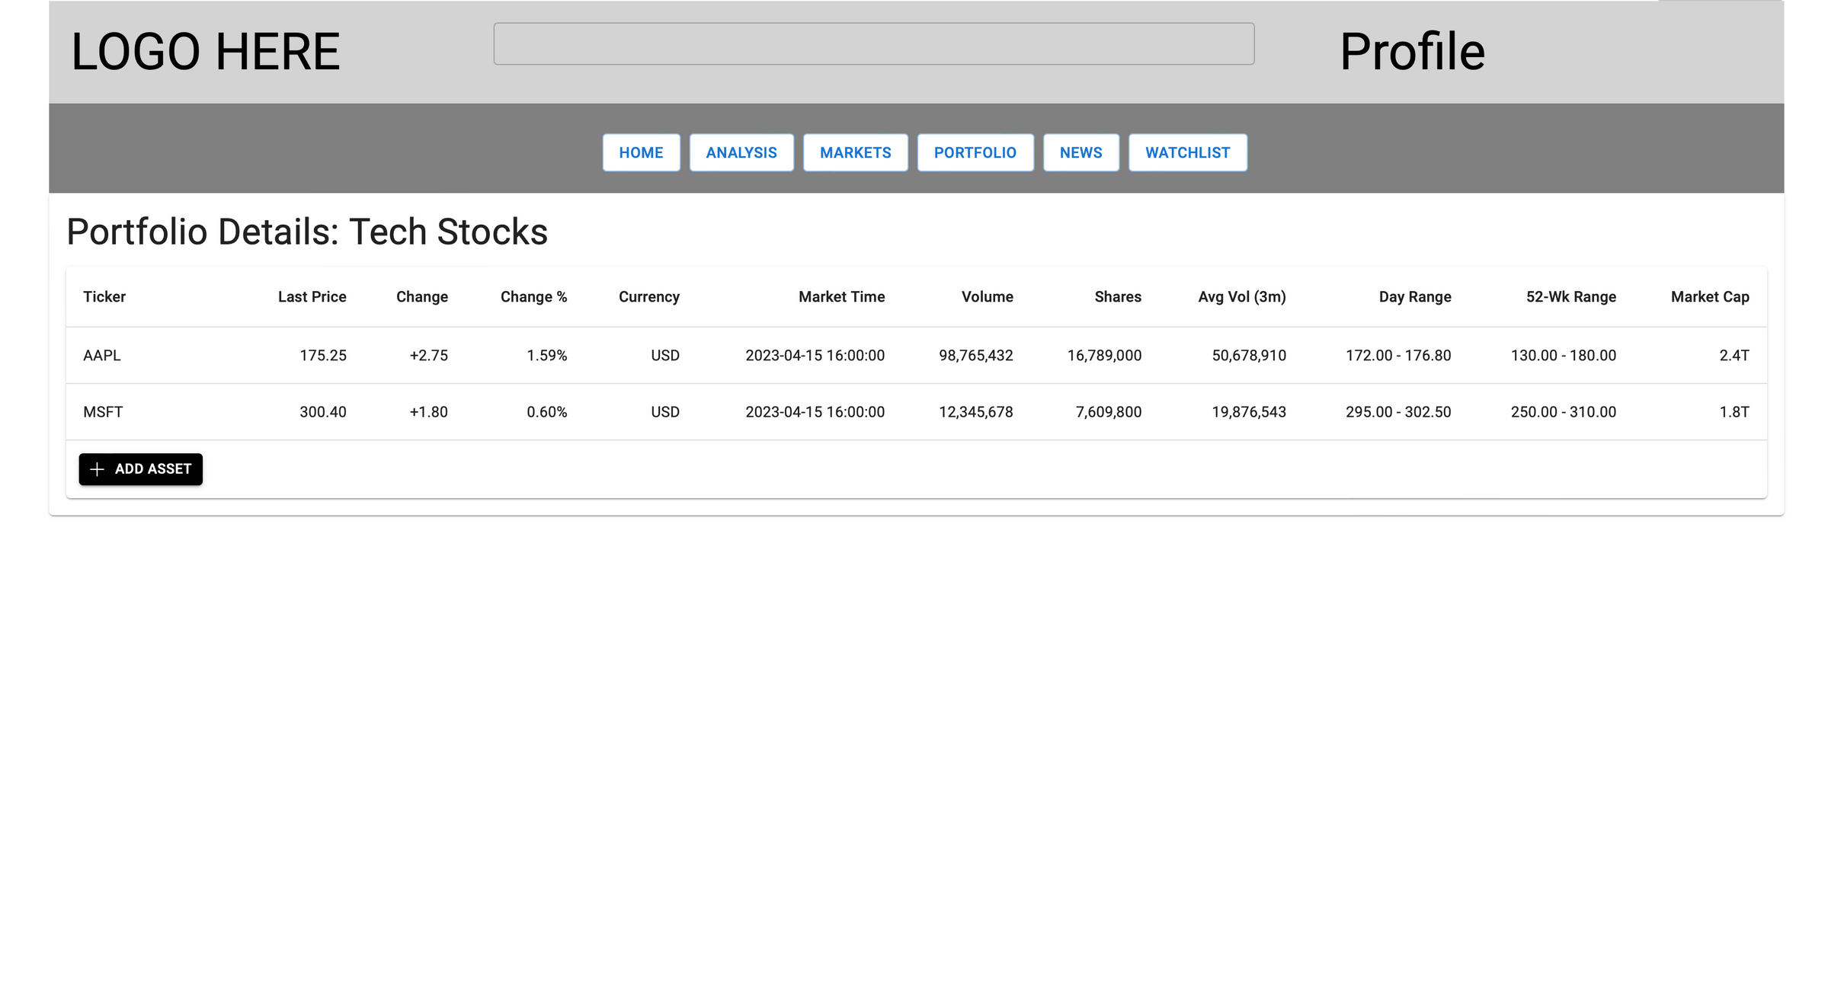

Slide 14
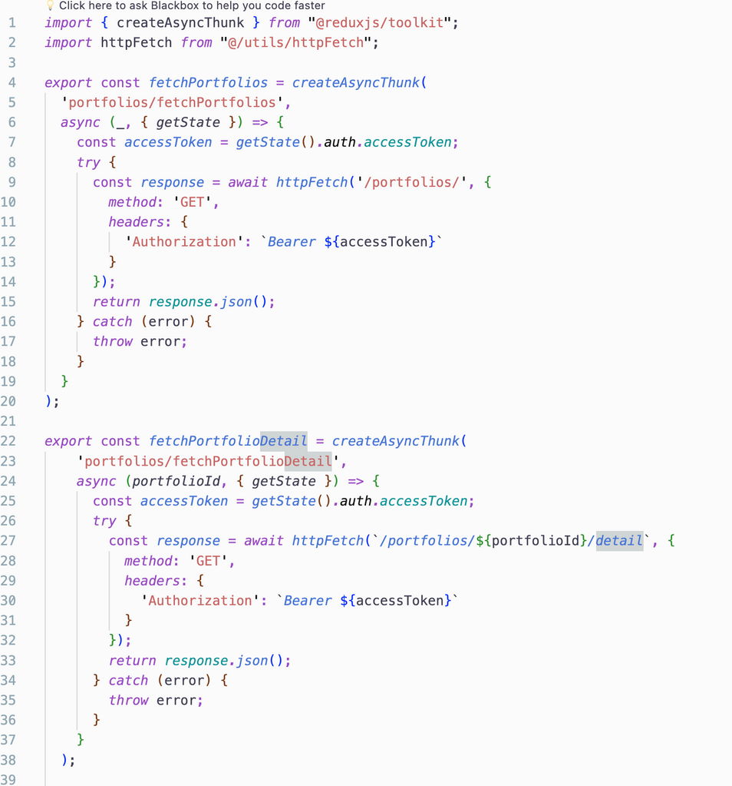
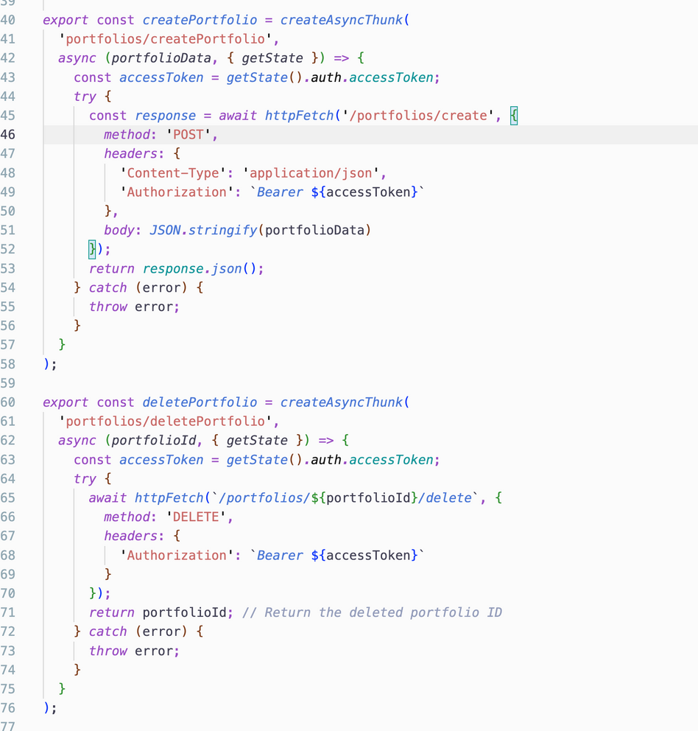
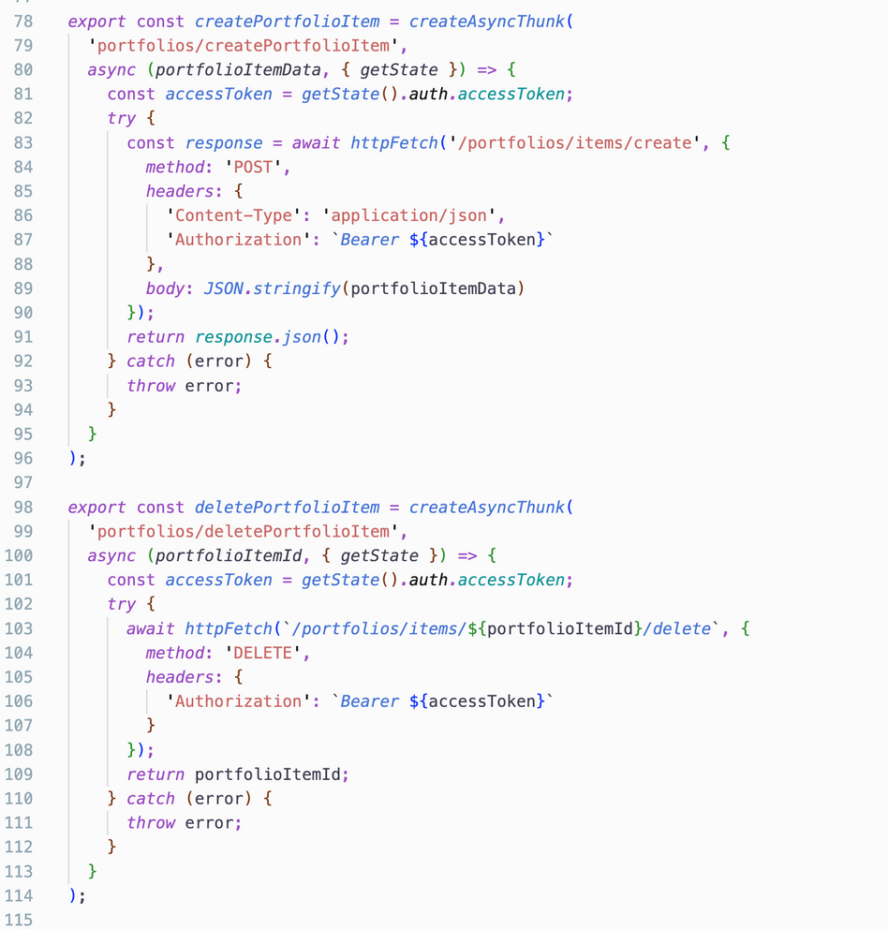
Portfolio Endpoints

